Slide 1

Emergency_alert
Project Seminar on
Guided by: Presented by:
Dr. Manoj S. Chaudhari
Priyadarshini Bhagwati College of Engineering, Nagpur (M.S.)
Department of Information Technology
Session: 2021-2022
Ayush khodankar
Rajlaxmi Meshram
Ankush Wadode
Jaykumar Zade
Ayush Wandharee

Slide 2
Contents
Introduction
Problem statement
Aim & Objectives
Proposed Methodology
Module Distribution
H/W & S/W Requirement
Conclusion
References

Slide 3
Introduction
“Emergency-Alert” will be a software that will handle different direction of hospital workflow.
It will register the hospitals along with all details specifically vacant bed details .
If any emergency happens, this software will give the information about bed availability.
It will be a Web Based for administrator, hospital managers, doctors and users.

Slide 4
Problem Statement
This problem is proposed by Government Of Rajasthan through Smart India Hackathon 2022.
The proposed problem is to get the information about the occupancy of bed and necessary items for the patients especially in emergency cases, an electronic system must be brought into usage to identify them to aware the patients and to make them to easy to find.

Slide 5
Aim:
To develop a software which will help to book emergency beds in hospitals.
Objectives:
The main problem of bed allotment in various hospitals for patients at the time of emergencies will be reduced .
This software will provide easy tracking of vacant beds in various hospitals.
This proposed software will provide easy maintainence of data for hospital managers.

Slide 6
ADMIN MODULE :
This module will monitor all information regarding the hospitals for particular area like bed availability and doctors availability.
Admin will register all hospitals for the particular area.
Hospital manager , Doctors and Patient details, vacant bed details will be stored in admin database.
Data updation, deletion and insertion of new data can be done by admin.

Slide 7
HOSPITAL MANAGER MODULE :
Hospital manager can login to the system by the ID , Password which will be allotted by the admin.
Hospital Manager can enter Patient and Doctor information in the hospital .
Hospital Manager will enter vacant bed information on daily basis .

Slide 8
DOCTOR MODULE :
Doctor can update their own information .
Doctors can see the schedule and emergency cases allotted to them.
Doctors can receive message for emergency cases.

Slide 9
USER MODULE :
User can see the vacant bed information in nearby hospital in case of emergency.
The user of this app can book bed in case of emergency.
Once the user books the bed for emergency case, SMS will be sent automatically to Doctor,
Ambulance and Hospital manager.
User can book ambulance for emergency cases.
User can contact to admin for emergency bed allotment.
Feedback system will be available for setting the priorities among hospitals reviewed by User.

Slide 10
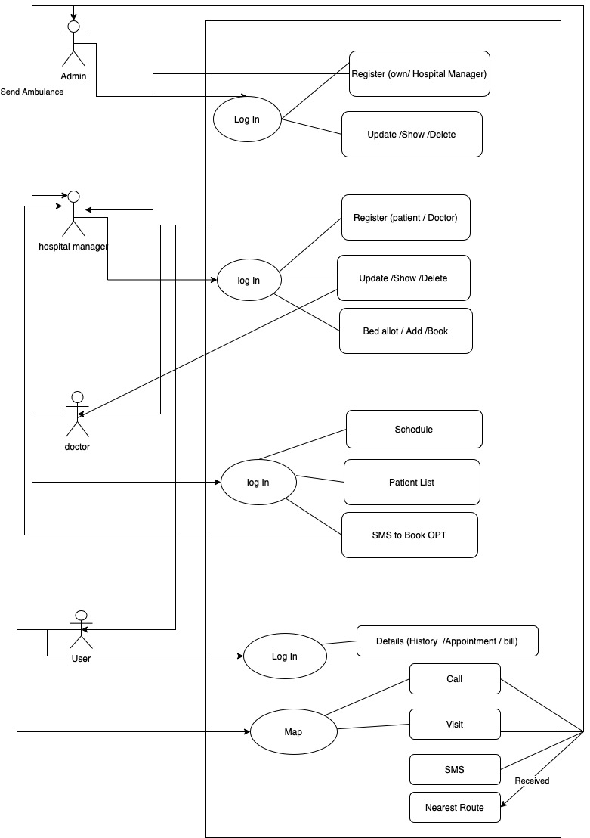
Proposed Methodology:

Slide 11
H/W S/W Requirement
Minimum Hardware Requirements:
256 SSD Storage
4 GB RAM
2-core CPU
Network card
Software requirement:
HTML, CSS, JavaScript
Java For Backend Workings

Slide 12
Conclusion:
This proposed software is the inevitable part of life cycle of part of medical institution.
Problems of bed bookings at the time of emergency cases will be reduced.
It enables smooth interactions between user side and hospital side.
Implementation of this system provides record management of the total patients.

Slide 13
Thank You

